Slide 1
Contents
Software Testing

Slide 2

Common software problems!
Common software problems!
What are the problems you encounter as software users?
Incorrect calculation
Incorrect data edits & ineffective data edits
Incorrect matching and merging of data
Data searches that yield incorrect results
Incorrect processing of data relationship
Incorrect coding/processing of business rules
Inadequate software performance
Confusing or misleading data
Inconsistent processing
Unreliable results or performance
Incorrect or inadequate interfaces with other systems
Incorrect file handling

Slide 3
Who is responsible for testing?
Who is responsible for testing?

Slide 4
Objectives of a software tester
Find bugs as early as possible and make sure they get fixed
To understand the application well
Study the functionality in detail to find where the bugs are likely to occur.
Study the code to ensure that each and every line of code is tested.
Create test cases in such a way that testing is done to uncover the hidden bugs and also ensure that the software is usable and reliable

Slide 5
Objectives of testing
Executing a program with the intent of finding an error
To check if the system meets the requirements and be executed successfully in the Intended environment
To check if the system is “ Fit for purpose”
To check if the system does what it is expected to do
A good test case is one that has a probability of finding an as yet undiscovered error
A good test is not redundant
A good test should neither be too simple nor too complex

Slide 6
Confusing but related!!!
Verification (Are the algorithms coded correctly?)
The set of activities that ensure that software correctly implements a specific function or algorithm
Involves reviews and meeting to evaluate documents, plans, code, requirements, and specifications.
Usually done with checklists, walkthroughs, and inspection meeting.
Validation (Does it meet user requirements?)
The set of activities that ensure that the software that has been built is traceable to customer requirements
Involves actual testing and takes place after verifications are completed.
Validation and Verification process continue in a cycle till the software becomes defects free.

Slide 7
SOFTWARE
TESTING

Slide 8
What is Software Testing?
A process of analyzing a software item to detect the differences between existing and required conditions (that is defects / errors / bugs) and to evaluate the features of the software item
[IEEE]

Slide 9
DEFINITIONS AND PROCESS

Slide 10
Basic Definitions – Test
Testing is obviously concerned with errors, faults, failures, and incidents
"A test is the act of exercising software with test cases"
A test has two distinct goals:
To find failures or
Demonstrate correct execution
[IEEE]
Test

Slide 11
Basic Definitions – Test Case
Test case has an identity and is associated with a program behavior
A test case also has a set of inputs and a list of expected outputs
Test Case
[IEEE]

Slide 12
Contents of a Test Case
"Boilerplate": Author, Date, Purpose, Test Case ID
Pre-Conditions
Inputs
Expected Outputs
Observed Outputs
Test Case
[IEEE]

Slide 13
S/W Testing lifecycle phases
Requirements study
Analysis and planning
Test Case Design and Development
Test Execution
Test Closure
Test Process Analysis

Slide 14
Requirements study
Testing Cycle starts with the study of client’s requirements.
Understanding of the requirements is very essential for testing the product – Why?.

Slide 15
Analysis & Planning
Test objective and coverage
Overall schedule
Standards and Methodologies
Resources required, including necessary training
Roles and responsibilities of the team members
Tools used

Slide 16
Test Case Design and Development
Component Identification
Test Specification Design
Test Specification Review
To Maximize the Coverage

Slide 17
Test Execution
Code Review
Test execution and evaluation
Performance and simulation

Slide 18
Test Closure
Test summary report
Project De-brief
Project Documentation

Slide 19
Test Process Analysis
On the reports
To improve the application’s performance by implementing new technology and additional features

Slide 20
A Strategy for Testing Conventional Software
System Testing
Narrow to Broader
Scope
Validation Testing
Integration Testing
Unit Testing
Code
Abstract to
concrete
Design
Requirements
System Engineering

Slide 21

Testing a Ballpoint Pen
Does the pen write in the right color, with the right line thickness?
Is the logo on the pen according to company standards?
Is it safe to chew on the pen?
Does the click-mechanism still work after 100 000 clicks?
Does it still write after a car has run over it?

Slide 22
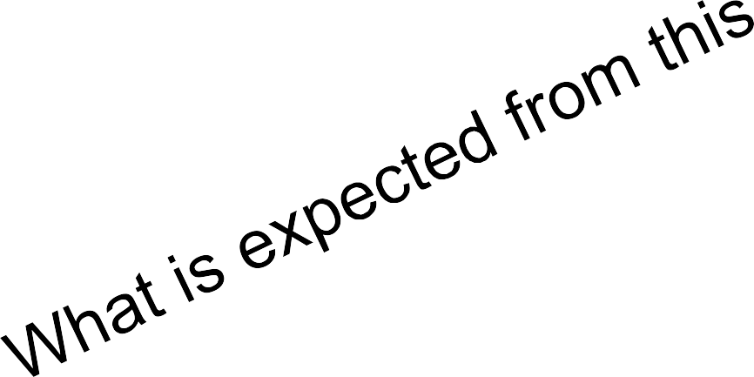
Testing a Ballpoint Pen
Does the pen write in the right color, with the right line thickness?
Is the logo on the pen according to company standards?
Is it safe to chew on the pen?
Does the click-mechanism s
till work after
Intended use!!
100 000 clicks?
Does it still write after a car has run over it?

Slide 23



Testing a Software
Software testing is not that different from testing in other disciplines
Bridges: verify requirements, design, construction
Cars: verify requirements, design, construction
Software: verify requirements, design, implementation
But software is often much harder!

Slide 24
TESTING APPROACHES

Slide 25
Testing Levels
Unit testing
Testing individual functions, classes and modules
Does not catch faults related to interactions
Integration testing
Test interactions between units
Based on specification of how units are expected to communicate
Does not catch faults related to entire system

Slide 26
Testing Levels
System testing
Tests entire system as a whole with focus on requirements
Can be hard to test exceptional conditions at this
level
Acceptance testing
Test that system meets customer requirements, often performed by customer

Slide 27

Basic Testing Approaches
Specification
Program
Functional (Black Box)
Structural (White Box)

Slide 28
Black Box
Function is understood only in terms of it's inputs and outputs, with no knowledge of its implementation
inputs
Outputs

Slide 29
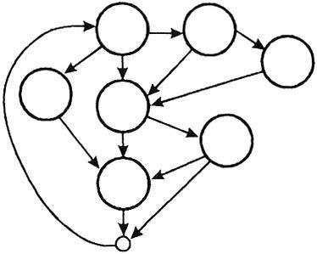
White Box
Function is understood only in terms of its implementation
inputs
Outputs

Slide 30
Types (Strategy) of testing
Black-box: A strategy in which testing is based on requirements and specifications
White-box: A strategy in which testing is also
based on internal paths, structure, and implementat

Slide 31
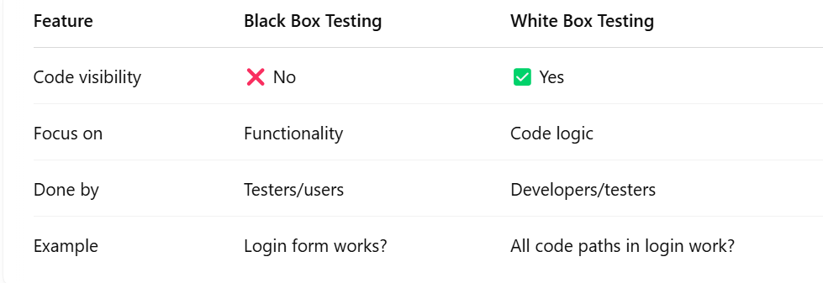
Difference

